Slide 1
Intellectual Property Rights and Entrepreneurship
Professor Ruth Soetendorp
iprsoet@gmail.com

Slide 2
Why IP education is important: young Business School students speak
Its very important and useful in terms of business environment and especially for entrepreneurs
I want to be an entrepreneur I wanted to be well informed before starting up my own business by knowing the bases
Its crucial having a knowledge of IPR, not only for managing them or advising others but more importantly if you become an inventor or entrepreneur
As a future entrepreneur it is necessary to know about the laws surrounding a business
As I want to create my own business with my own idea it is very important to have knowledge in this specific area

Slide 3
IPR Portfolio = IPR + Quasi IPR
IPRs: Patents*, Planter Breeders rights, reg Designs*, unreg Design Right, RegTrade Marks*; Copyrights, moral rights, Performers Rights, Chip Topographies, Geographical indications*
Quasi IP: Confidential Information, Know How, Trade Secrets, Reputation/Passing off, Traditional knowledge and indigenous peoples’ rights

Slide 4
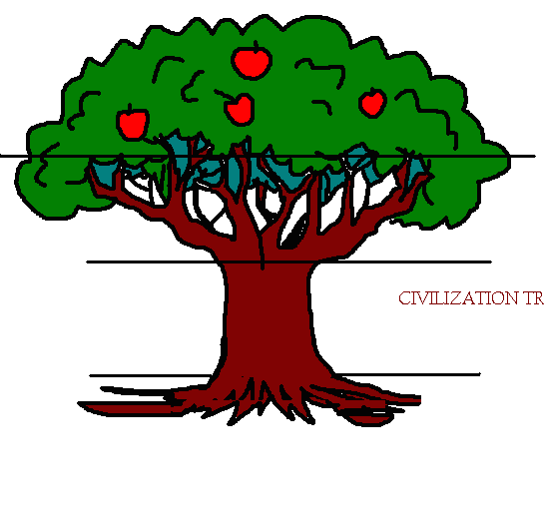
Intellectual Property tree
1. Recognition +
Protection +
Exploitation:
Licensing
Valuation
Marketing +
Enforcement =
Competitive Advantage

Slide 5

Patent Strategy: Who invented the light bulb?
Thomas Edison is famous for inventing the light bulb. His thin filament bulb was a patentable improvement over his rivals’ patented thick filament bulb. Edison bought up their patents for $50,000 before he started development, so they wouldn’t sue him for infringement after Edison became commercially successful.

Slide 6
Patents – difficult to value, but…
in 2011 Google in Motorola Mobility acquisition bought 17,00 patents for $12.5bn at approx $735K per patent to protect its Android mobile operating system from rivals
6,000 Nortel patents bought for $4.5bn i.e. $750 per patent
2012 Microsoft acquired 800 patents from AOL for more than $1bn, then sold 70% of them to Facebook for $550 million
2013 Kodak, the bankrupt company that invented the digital camera, sold its portfolio of 1,100 digital photography-related patents to a dozen licensees, including Apple, Microsoft, and Google $525 million.
http://www.forbes.com/sites/forbesleadershipforum/2013/06/25/how-to-tell-what-patents-are-worth/

Slide 7
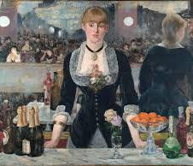
Trade Marks
Protect for ever, build up loyal following
BASS beer, 1880s to present day

Slide 8
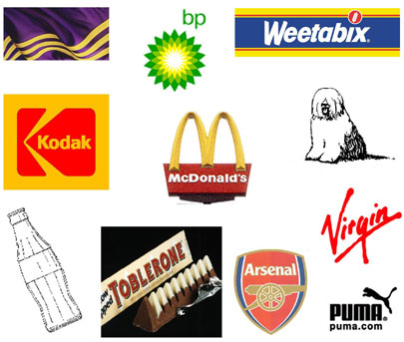
Trade Marks
Law of Trade Marks
( ® , ™)
Registration of signs,
names, logos, etc to
protect the goodwill
of a product or
enterprise

Slide 9

Turkish online ‘market place’ bought by ebay, but brand identity retained, thanks to ® trade mark

Slide 10
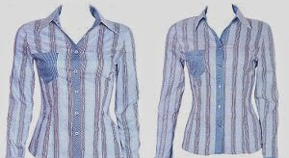
Unregistered Designs Karen Millen v Dunnes Stores 2014

Slide 11
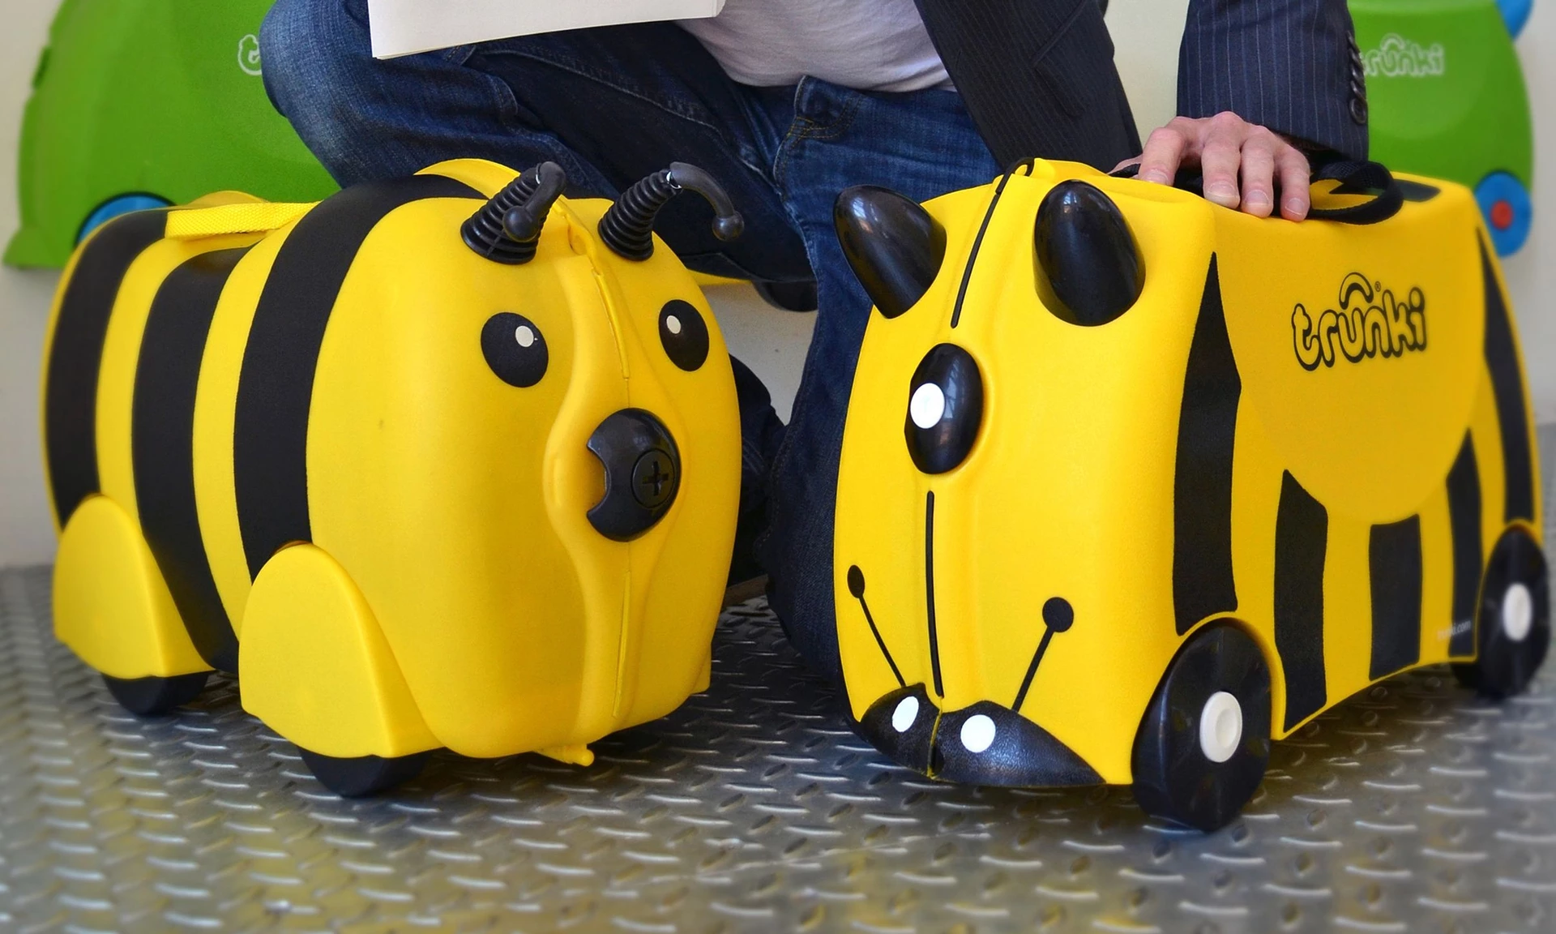
UK Supreme Court case study: Trunki

Slide 12
Trunki: childrens travel case (design)
Hugely popular = Huge market
Trunki protected by Registered Design.
Copied/Adapted by Kiddee
Are the changes Kiddee made sufficiently significant?
NB Trunki haven’t PATENTED the case, they have registered the design
Different criteria for different rights

Slide 13
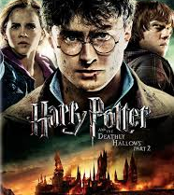
Copyrights and Brands
JK Rowling according to Forbes 2007 – net worth = 1$ billion
10% royalties but probably doing better
Currently estimated at $15 billion
http://interbrand.com/best-brands/best-global-brands/2015/ranking/

Slide 14
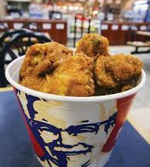
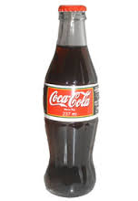
Trade Secrets & Know How
Coca Cola & Kentucky Fried Chicken built international empires on trade secrets. Risks from employees and suppliers

Slide 15
UK Case Study
Mandy Haberman, mother housewife and successful business woman whose success is built on protecting her intellectual property, and defending it against bigger competitors
“My patents cause me aggravation. My trade marks sit in a corner quietly earning me royalties”
Anywayup® Cup
http://worldwide.espacenet.com/publicationDetails/biblio?DB=worldwide.espacenet.com&II=1&ND=3&adjacent=true&locale=en_EP&FT=D&date=20000815&CC=US&NR=6102245A&KC=A

Slide 16
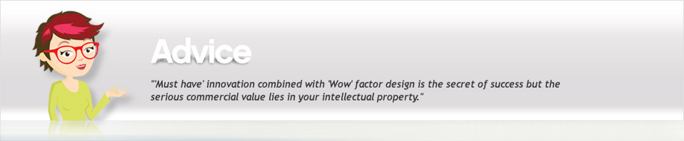

Mandy Haberman’s anywayup® cup
A successful case study
A simple invention
A good patent
Serious competitors
Determination to win
An attractive product
Commercial success!

Slide 17
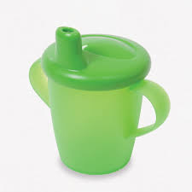
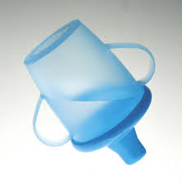
Anywayup® Cup
Shake, rattle and roll - world's first totally non-spill cup. The Design Business Association said “Anywayup® Cup results are extraordinary, 70 people were employed on the back of this product, marketing was done by word of mouth and it dominates the sector."
Anywayup® Cup revolutionised the baby products market thanks to its ability to genuinely solve a major headache of parenthood."
”It eliminates spillage - yes it really does - but the design also protects growing teeth by allowing a flow of juice only when the child sucks and swallows. Add this to a range of contemporary colours that promise to fit in effortlessly with the most modern kitchen and you have the ultimate baby must-have.”

Slide 18
Anywayup® cup
Intellectual property rights
Patents for novelty & inventive step (successful litigation against international competitors)
Registered design for the new impression on the informed user
Registered trade mark®

Slide 19
Promoting and Protecting IP in Turkey
International Chamber of Commerce 2011
Business Action to stop Counterfeiting and Piracy
Why is IP important to the integration of Turkey into the global economy?
IP protects the economy: GDP, employment, tax revenues, development and competitiveness
IP promotes foreign direct investment and technology transfer
IP protection benefits consumers, drives solutions to society’s needs
IP promotes innovation, increases R&D funding, helps firms realise innovation value
IP helps firms monetize innovations, secure investment, grow market value, develop new markets
IP protection helps SMEs; IP reliant SMEs report up to 20% higher growth

Slide 20
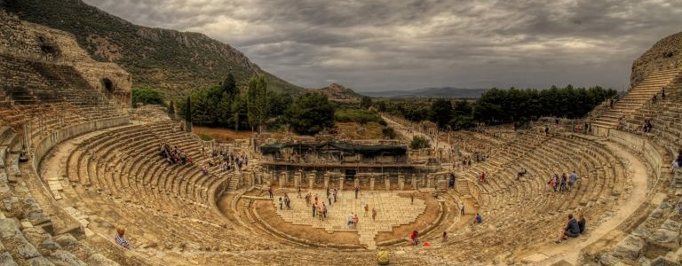
Turkish Case study: Afyon marble
Afyon Marble has been used for millennia in major structures such as the Theatre of Ephesus in present-day Selcuk, Izmir Province, Turkey (Photo: Flickr/Neil Howard)

Slide 21

A Turkish IP case study
Afyon Marble – is a protected geographical indication registered with TPI in 2003
Marble can only be called Afyon if it is mined in the Afyon region and meets certain standards
World Intellectual Property
Organisation case study:
http://www.wipo.int/ipadvantage/en/details.jsp?id=4741

Slide 22
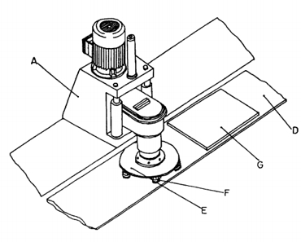

Tureks Patents and ®Trade Marks

Slide 23
Tureks: patents for inventions
An innovative simulated ageing process for marble
Cost effective, produces an attractive surface
(patented)
Reinforcing stone products increases the stone’s robustness
Reduces waste by reducing chance of rupture in the stone
(patented)

Slide 24
Tureks® trade marks build a brand
Branding is an important strategy for Turek, trademark registration (Image: TPI#2003/11146)
2014 the SME had over 35 trademark registrations with TPI, including for the company’s name and logo (#2003/11146);
slogans such as Marble From Turkey (#96/019118);
product names such as Avalon (#2009/69252), Royal Cream (#2014/56936), and Silver Shadow (#2009/69304).
Domain names have also been important to Turkish companies selling Afyon Marble products as a way to reach international markets.
Tureks owns multiple domain names such as tureksstone.com and tureks.com.tr.

Slide 25
How does IP build value?
Freedom to operate – patent monopoly rights to stop others
Product differentiation – in the market place from ® trade marks
Revenue - from IP licensing
Tax benefits – depends on tax regime
Enabling new technology
Attracting investment – in protected IP
Positive image – build reputation and brand
Clarification of ownership – avoids costly commercial disputes

Slide 26
Competitive Advantage
Intellectual Property rights owners outshine their competitors in economic performance.
Companies owning IPRs have, in general, 29% higher revenue per employee, about six times as many employees and pay wages that are up to 20% higher than firms which do not own any IP.
About 40% of total economic activity in the EU (some €4.7 trillion annually) is generated by IPR-intensive industries, and approximately 35% of all employment in the EU (77 million jobs) stems directly or indirectly from industries that have a higher-than-average use of IP rights.
https://oami.europa.eu/ohimportal/en/web/observatory/news/-/action/view/2189009

Slide 27
IP is important – IDEAS MATTER
“IP helps innovation and creativity - Once you understand the importance of IP you need to know how to deal with it”
http://ideasmatter.com/media/files/Science_Business_IP_report.pdf
.
“IP plays a significant role in companies growth, attracts investment, protects against competitors, makes them stand out from the crowd and increases credibility.”
“Protecting IP is expensive and laborious - more than 50% unprepared to deal with the
complexities of IP at the point they start their companies”

Slide 28
Thank You!
Professor Ruth Soetendorp
Associate Director,
Centre for Intellectual Property Policy & Management
Bournemouth University
AND
Cass Business School, City University of London

